Slide 1
Internship Presentation
Alexia Wells and Leo Huang
Notes:
Good morning everyone! Our names are… We are excited to present today about our experience at ST Engineering iDirect and what are takeaways are.

Slide 2
Leo
About Us
Alexia
Rising senior at University of Michigan
Studying Computer Engineering
Software Engineering Intern
Team = QoS
Rising senior at Brigham Young University
Studying Statistics:Data Science and Spanish
Hobbies: Playing guitar, learning languages, and reading
Software Engineering Intern
Team = NetDev

Slide 3
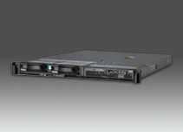
What Leo Worked On
Satellite Training
Testing and Support
Unit Tests
Code Review
UI Tests (Pulse, Spirent)
Bug Documentation

Slide 4
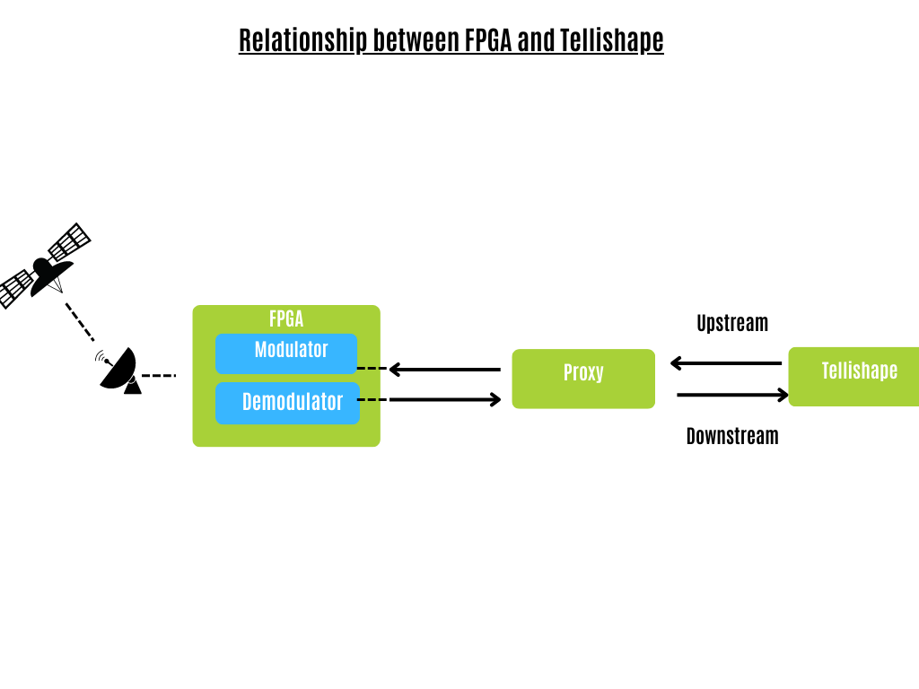
What Alexia Worked On
Confluence documentation - Development Setup and FPGA/Tellishape Communication
Atomic operations, epoll loops, ring buffers, diagrams
Studying - PP_TPA Process Flows
Unit testing - icmp_v4_intercept files
GoogleTest
Docker
Git
Bitbucket
Notes:
At the start of the internship, I began preparing for the Azure Virtual Modem project. Like many other interns, early on, I spent some time setting up my development environment. My first task was to keep track of this set up and document it in confluence. For me, this was a nice transition into the company and how to use confluence.
Next, I created a document describing how Tellishape and the FPGA were currently operating, specifically describing the ring buffers used to send data between them. In order to create this page, I had to spend time not only studying the code, but concepts like atomic operations, epoll loops, and ring buffers. In this document, I even created diagrams of several working pieces in the code.
I did not come into this experience realizing just how much writing goes on as a software engineer. It seems that there is constantly a concept document to create or update. This writing process is essential for accessibility so that someone can come along and understand code from the past. I appreciated gaining this insight, learning the importance of being able to explain the details and learning how to write these documents myself.
Then, the Azure Virtual Modem project was put on pause and I began to study PP_TPA process flows from the pcstl directory. There were a few other individuals on the team with this ticket as well. I know that I’ve always heard that going into the tech field means you are always learning and studying and this has certainly been true. It has been impressive to see how very experienced coders are open minded and continue to learn new methods of writing efficient code.
Most recently, I have been focusing on unit testing. As I mentioned earlier, I come from a Statistics background and only took a few C++ classes, therefore I never reached a point
where I learned about unit testing so this has been a great experience. I have been specifically working on unit testing for the icmp_v4_intercept files. St Engineering iDirect uses google tests in order to do this, I spent plenty of time looking at the GoogleTestPrimer which is a helpful website that teaches you the basics.
I also gained experience in Docker, I even have certain commands memorized now like how to check for containers, start a container, and execute one.
I won’t get too much into the technical details, but my current code checks to see whether or not a packet is successfully pushed up or down into a protocol layer. Through this process, I was introduced to vlan,ip, icmp and tcp headers and callback functions. This was my first time working with such a big project, so I also learned how to look through files for certain classes or functions. Also, how to effectively order headers and follow the company's style conventions.
I was able to use git and better learn the basic commands to create pull requests. Committing my first request was an eye opening experience because I received feedback on what to change/improve, add or delete. Overall as an engineer, it is always important to be receptive to others suggestions and if there is confusion it opens the door to more conversation.

Slide 5
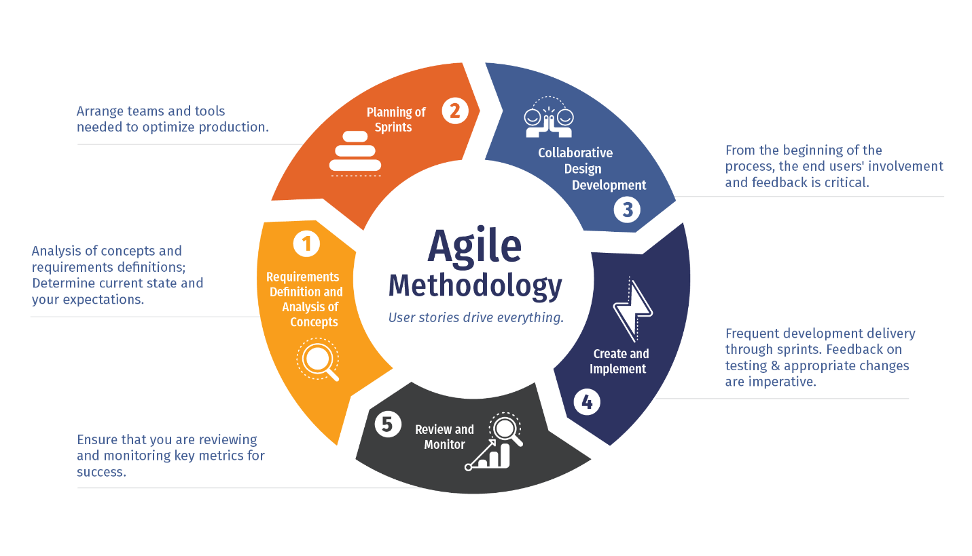
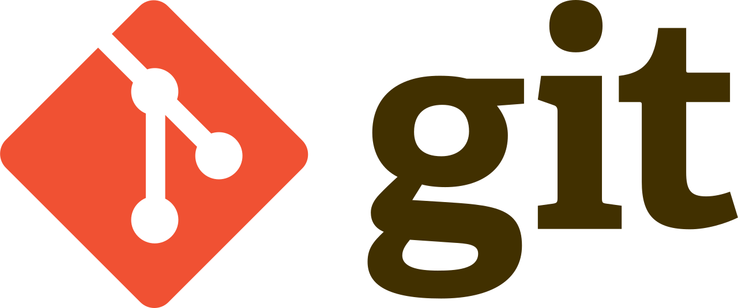
Skills Learned and Used
Agile Methodology
Jira, Confluence, Bitbucket
Linux, Git, Docker, Jenkins
Satellite Communications
Advanced C++
Notes:
During the internship, the one the most important concept we learned and experienced was the agile method. We previously have never heard of agile, and just assumed that people just worked on tasks as they came along. However, we quickly saw how important a solid work plan was to being able to complete large projects. Not only does it streamline the tasks, but it also allows for review and retrospective of work from yourself and the whole company which we came to know is very important for growth and successful teamwork.
Navigating the Jira site was a learning curve, but having all of the tasks and resources organized in one area makes it much more simple to be aware of the current situation in work. Furthermore, tools like git and jenkins are essential to organizational development and streamlining its process. All of these tools come back to the agile method and teamwork.

Slide 6
Teamwork in the Workspace
Collaboration/Communication
Daily Stand Up
Team retrospective
Bitbucket Code Review
Clean code
Notes:
Overall, this internship has taught Leo and I so much about the culture of the company and the importance of teamwork.
I have been impressed in watching my teams communication and collaboration, especially during the daily stand up and team retrospectives. They are able to clearly explain what they are doing in their tasks or what blocks they are facing. Not only that, but they are able to discuss different ways of approaching a problem. Members are able to say, “hey, I see what you are saying there but what if you tried this”? Everyone is open minded and I believe this collaboration creates a good culture of supporting one another.
Reviewing code in Bitbucket is another example of this process. As the person submitting the pull request, it is important to be receptive to the suggestions of others because the code we write can affect others work too. As the reviewers of the pull request, it is important to give constructive criticism. It is always nice to have a fresh set of eyes looking at code because they may notice something you did not.
Again, I briefly mentioned this earlier while I was speaking what I worked on but clean code matters! Our code should be understood by others so it is important for that to be consistent, clean, and have comments as necessary.

Slide 7
Class vs. Internship
Engineers wear jeans!
Being part of larger teams
Working with larger scaled projects
Cognizant of others jobs
Readily available to communicate
Documentation and technical writing
Accountability
Constructive Criticism
Notes:
Class usually working with one other person (usually your friend), here my team was 10 people who I have never met before. (L)
In my previous semester I was taking my data science capstone, the max amount of people I ever worked with was 3 and I didn’t initially know them. This created a nice transition to this internship. Capstone was only relevant for just my group, but in the internship you do need to care about the tasks of different teams and everything has an effect on eachother. (A)
What we do here other people care about as it affects everyone.
It is important to be mindful of others time

Slide 8
Thank You

